Slide 1
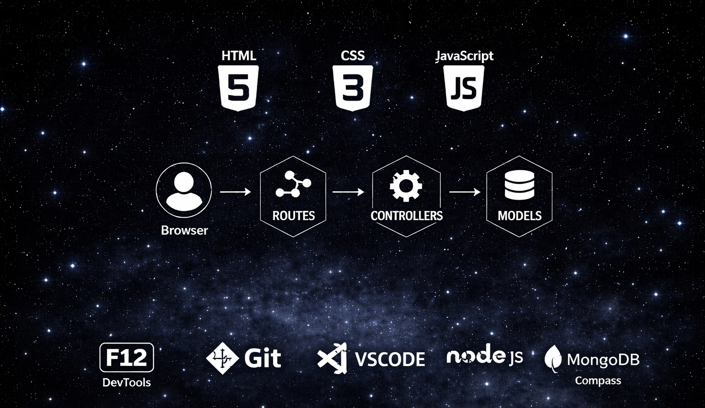
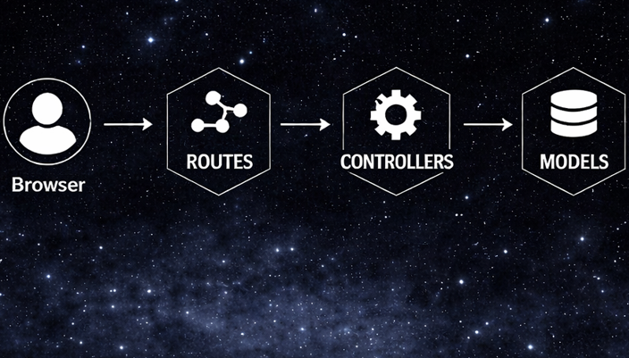


Slide 2

EXPRESS ARCHITECTURE
Client
→ Server Layer
→ Logging Layer
→ Configuration Layer
→ Authentication Layer
→ Schema Validation Layer
→ Middleware Layer
→ Routing Layer
→ Controller Layer
→ Domain Layer
→ Service Layer
→ Repository Layer
→ Data Layer
→ Response
→ Global Error Handler

Slide 3
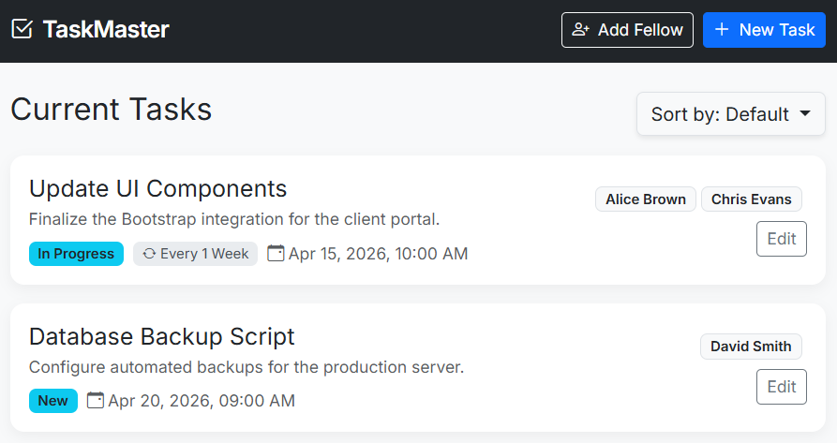
CLIENT-SIDE DESIGN
// public/TaskManager.html

Slide 4
CLIENT-SIDE DATA STRUCTURE
// public/TaskManager.js
let fellows = [
{
name: "Alice Brown",
email: "alice.brown@example.com"
},
{
name: "Chris Evans",
email: "chris.evans@example.com"
},
{
name: "David Smith",
email: "david.smith@example.com"
}
];

Slide 5
CLIENT-SIDE DATA STRUCTURE
// public/TaskManager.js
let tasks = [
{
id: 101,
title: "Update UI Components",
description: "Finalize the Bootstrap integration for the client.",
status: "In Progress",
deadline: "2026-04-15T10:00",
repeatEvery: 1,
repeatUnit: "Week",
fellows: [
"alice.brown@example.com",
"chris.evans@example.com"
]
},
];

Slide 6
CLIENT-SIDE API CALLS
// public/TaskManager.js
async function loadFellows() {
try {
const res = await fetch('/api/fellows'); // GET FELLOWS
fellows = await handleJsonResponse(res);
renderFellowsSelect();
} catch (error) {
alert('Error loading fellows: ' + error.message);
}
}

Slide 7
CLIENT-SIDE API CALLS
// public/TaskManager.js
async function createFellow() {
// CLIENT-SIDE VALIDITY CHECK HERE …
try {
const res = await fetch('/api/fellows', {
method: 'POST',
headers: { 'Content-Type': 'application/json' },
body: JSON.stringify({ name, email }),
});
const newFellow = await handleJsonResponse(res);
fellows.push(newFellow);
renderFellowsSelect();
addFellowForm.reset();
addFellowModal.classList.add('d-none'); // HIDE FELLOW FORM
} catch (error) {
alert('Error creating fellow: ' + error.message);
}
}

Slide 8
CLIENT-SIDE API CALLS
// public/TaskManager.js
async function loadTasks(sortBy) {
try {
const res = await fetch('/api/tasks'); // GET TASKS
tasks = await handleJsonResponse(res);
renderTasks(sortBy);
} catch (error) {
alert('Error loading tasks: ' + error.message);
}
}

Slide 9
CLIENT-SIDE API CALLS
// public/TaskManager.js
async function createNewTask(payload) {
try {
const res = await fetch('/api/tasks', {
method: 'POST',
headers: { 'Content-Type': 'application/json' },
body: JSON.stringify(payload),
});
const created = await handleJsonResponse(res);
tasks.push(created);
renderTasks();
addTaskForm.reset();
addTaskModal.classList.add('d-none'); // HIDE TASK FORM
} catch (error) {
alert('Error creating task: ' + error.message);
}
}

Slide 10
CLIENT-SIDE API CALLS
// public/TaskManager.js
async function updateExistingTask(taskId, payload) {
try {
const res = await fetch(`/api/tasks/${taskId}`, {
method: 'PUT',
headers: { 'Content-Type': 'application/json' },
body: JSON.stringify(payload),
});
const updated = await handleJsonResponse(res);
const idx = tasks.findIndex(t => String(t.id) === String(taskId));
if (idx !== -1) tasks[idx] = updated;
renderTasks();
addTaskForm.reset();
addTaskModal.classList.add('d-none'); // HIDE TASK FORM
} catch (error) {
alert('Error updating task: ' + error.message);
}
}

Slide 11
EXPRESS ARCHITECTURE
Client
→ Server Layer
→ Logging Layer
→ Configuration Layer
→ Authentication Layer
→ Schema Validation Layer
→ Middleware Layer
→ Routing Layer
→ Controller Layer
→ Domain Layer
→ Service Layer
→ Repository Layer
→ Data Layer
→ Response
→ Global Error Handler

Slide 12
SCHEMA EXTENSION
// schema/csvSchemas.js
export const csvSchemas = { // filename --> columns
'fellows.csv': {
columns: ['name', 'email']
},
'tasks.csv': {
columns: [
'id',
'title',
'description',
'status',
'deadline',
'repeatEvery',
'repeatUnit',
'fellows' // Email addresses separated by semi-colon
]
}
};

Slide 13
MANAGE FELLOW REPOSITORY
// repositories/fellowRepository.js
import path from 'path';
import { csvSchemas } from '../schema/csvSchemas.js';
import { readCSVFile, writeCSVFile, csvToJson, jsonToCsv }
from '../data/csvAdapter.js';
const FILE_NAME = 'fellows.csv';
const FILE_PATH = path.join(process.cwd(), 'data', FILE_NAME);
const schema = csvSchemas[FILE_NAME];
let fellows = [];
async function loadFellows() {
const csv = await readCSVFile(FILE_PATH);
if (!csv) {
const emptyCSV = jsonToCsv([], schema);
await writeCSVFile(FILE_PATH, emptyCSV);
return;
}
fellows = csvToJson(csv, schema);
}

Slide 14
MANAGE FELLOW REPOSITORY
// repositories/fellowRepository.js
async function saveFellows() {
const csv = jsonToCsv(fellows, schema);
await writeCSVFile(FILE_PATH, csv);
}
function getFellows() {
return fellows;
}
async function addFellow(name, email) {
const newFellow = { name, email };
fellows.push(newFellow);
await saveFellows();
return newFellow;
}
export default { loadFellows, getFellows, addFellow };

Slide 15
MANAGE TASK REPOSITORY
// repositories/taskRepository.js
import path from 'path';
import { csvSchemas } from '../schema/csvSchemas.js';
import { readCSVFile, writeCSVFile, csvToJson, jsonToCsv }
from '../data/csvAdapter.js';
const FILE_NAME = 'tasks.csv';
const FILE_PATH = path.join(process.cwd(), 'data', FILE_NAME);
const schema = csvSchemas[FILE_NAME];
let tasks = [];
function deserializeTask(raw) {
return {...raw, fellows: raw.fellows ?
raw.fellows.split(';').map(s => s.trim()).filter(Boolean) : []};
}
function serializeTask(task) {
return {...task, fellows:
Array.isArray(task.fellows) ? task.fellows.join(';') : ''};
}

Slide 16
MANAGE TASK REPOSITORY
// repositories/taskRepository.js
async function loadTasks() {
const csv = await readCSVFile(FILE_PATH);
if (!csv) {
const emptyCSV = jsonToCsv([], schema);
await writeCSVFile(FILE_PATH, emptyCSV);
return;
}
const rawItems = csvToJson(csv, schema);
tasks = rawItems.map(deserializeTask);
}
async function saveTasks() {
const rawItems = tasks.map(serializeTask);
const csv = jsonToCsv(rawItems, schema);
await writeCSVFile(FILE_PATH, csv);
}
function getTasks() { return tasks; }

Slide 17
MANAGE TASK REPOSITORY
// repositories/taskRepository.js
async function addTask(task) {
const maxId = tasks.length > 0 ?
Math.max(...tasks.map(t => Number(t.id))) : 0;
const newTask = {...task, id: maxId + 1, fellows: task.fellows || []};
tasks.push(newTask);
await saveTasks();
return newTask;
}
async function updateTask(id, updates) {
const idx = tasks.findIndex(t => String(t.id) === String(id));
if (idx === -1) return null;
tasks[idx] = {...tasks[idx], ...updates};
await saveTasks();
return tasks[idx];
}
export default { loadTasks, getTasks, addTask, updateTask };

Slide 18
TRANSPARENT (PASS-THRU) SERVICE LAYERS
// services/fellowService.js
import repo from '../repositories/fellowRepository.js';
async function addFellow(name, email) {
return repo.addFellow(name, email);
}
async function getFellows() {
return repo.getFellows();
}
export default { addFellow, getFellows };

Slide 19
TRANSPARENT (PASS-THRU) SERVICE LAYERS
// services/taskService.js
import repo from '../repositories/taskRepository.js';
async function addTask(task) {
return repo.addTask(task);
}
async function getTasks() {
return repo.getTasks();
}
async function updateTask(id, updates) {
return repo.updateTask(id, updates);
}
export default { addTask, getTasks, updateTask };

Slide 20
EXPRESS ARCHITECTURE
Client
→ Server Layer
→ Logging Layer
→ Configuration Layer
→ Authentication Layer
→ Schema Validation Layer
→ Middleware Layer
→ Routing Layer
→ Controller Layer
→ Domain Layer
→ Service Layer
→ Repository Layer
→ Data Layer
→ Response
→ Global Error Handler

Slide 21
FELLOW CONTROLLERS
// controllers/getFellowsController.js
import fellowService from '../services/fellowService.js';
export default async function getFellowsController(req, res) {
const fellows = await fellowService.getFellows();
res.status(200).json(fellows);
}
// controllers/addFellowController.js
import fellowService from '../services/fellowService.js';
export default async function addFellowController(req, res) {
const { name, email } = req.body;
const newFellow = await fellowService.addFellow(name, email);
res.status(201).json(newFellow);
}

Slide 22
TASK CONTROLLERS
// controllers/getTasksController.js
import taskService from '../services/taskService.js';
export default async function getTasksController(req, res) {
const tasks = await taskService.getTasks();
res.status(200).json(tasks);
}
// controllers/addTaskController.js
import taskService from '../services/taskService.js';
export default async function addTaskController(req, res) {
const payload = req.body;
const created = await taskService.addTask(payload);
res.status(201).json(created);
}

Slide 23
TASK CONTROLLERS
// controllers/updateTaskController.js
import taskService from '../services/taskService.js';
export default async function updateTaskController(req, res) {
const taskId = req.params.id;
const updates = req.body;
const updated = await taskService.updateTask(taskId, updates);
if (!updated) {
return res.status(404).json({ error: "Task not found" });
}
res.status(200).json(updated);
}

Slide 24
FELLOW VALIDATION
// middleware/validateFellow.js
export default function validateFellow(req, res, next) {
const { name, email } = req.body;
if (!name || typeof name !== 'string' || name.trim() === '') {
return res.status(400).json({ error: "Fellow name is required" });
}
if (!email || typeof email !== 'string' || email.trim() === '') {
return res.status(400).json({ error: "Fellow email is required" });
}
next();
}

Slide 25
TASK VALIDATION
// middleware/validateTask.js
export default function validateTask(req, res, next) {
const { title, description, deadline,
status, repeatEvery, repeatUnit, fellows } = req.body;
if (!title || typeof title !== 'string' || title.trim() === '') {
return res.status(400).json({ error: "Task title is required" });
}
if (deadline && isNaN(Date.parse(deadline))) {
return res.status(400).json({ error: "Invalid deadline format" });
}
if (repeatEvery && isNaN(Number(repeatEvery))) {
return res.status(400).json({ error: "repeatEvery must be a number" });
}
if (fellows && !Array.isArray(fellows)) {
return res.status(400).json({ error: "fellows must be an array of emails" });
}
next();
}

Slide 26
TASK VALIDATION
// middleware/validateTaskId.js
export default function validateTaskId(req, res, next) {
const id = req.params.id;
if (!id || isNaN(Number(id))) {
return res.status(400).json({ error: "Invalid task ID" });
}
next();
}

Slide 27
FELLOWS ROUTES
// routes/fellowsRoutes.js
import { Router } from 'express';
import validateFellow from '../middleware/validateFellow.js';
import addFellowController from '../controllers/addFellowController.js';
import getFellowsController from '../controllers/getFellowsController.js';
const fellowsRouter = Router();
// GET /api/fellows
fellowsRouter.get('/', getFellowsController);
// POST /api/fellows
fellowsRouter.post('/', validateFellow, addFellowController);
export default fellowsRouter;

Slide 28
FELLOWS ROUTES
// routes/tasksRoutes.js
import { Router } from 'express';
import validateTask from '../middleware/validateTask.js';
import validateTaskId from '../middleware/validateTaskId.js';
import addTaskController from '../controllers/addTaskController.js';
import getTasksController from '../controllers/getTasksController.js';
import updateTaskController from '../controllers/updateTaskController.js';
const tasksRouter = Router();
// GET /api/tasks
tasksRouter.get('/', getTasksController);
// POST /api/tasks
tasksRouter.post('/', validateTask, addTaskController);
// PUT /api/tasks/:id
tasksRouter.put('/:id', validateTaskId, validateTask, updateTaskController);
export default tasksRouter;

Slide 29
EXPRESS ARCHITECTURE
Client
→ Server Layer
→ Logging Layer
→ Configuration Layer
→ Authentication Layer
→ Schema Validation Layer
→ Middleware Layer
→ Routing Layer
→ Controller Layer
→ Domain Layer
→ Service Layer
→ Repository Layer
→ Data Layer
→ Response
→ Global Error Handler

Slide 30
EXTENDED EXPRESS SERVER
// expressServer.js
…
import fellowRepo from './repositories/fellowRepository.js';
import taskRepo from './repositories/taskRepository.js’;
import fellowsRouter from './routes/fellowsRoutes.js';
import tasksRouter from './routes/tasksRoutes.js';
// ROUTES
…
app.use('/api/fellows', fellowsRouter); // new fellows API
app.use('/api/tasks', tasksRouter); // new tasks API
// LOAD CSV DATA BEFORE STARTING SERVER
…
await fellowRepo.loadFellows();
await taskRepo.loadTasks();

